Slide 1

Chapter 11
Data Link Control
(DLC)
School of Computer Science and Engineering
Pusan National University
Jeong Goo Kim

Slide 2
Ch. 11 Outline
    Outline
11.1 DLC Services
11.2 Data-Link Layer Protocols
11.3 HDLC
11.4 PPP

Slide 3
    Ch. 11 Objective
    Objective
The first section discusses the general services provided by the DLC sublayer.
The second section discusses some simple and common data-link protocols that are implemented at the DLC sublayer.
The third section introduces HDLC, a protocol that is the basis of all common data-link protocols in use today such as PPP and Ethernet.
The fourth section discusses PPP, a very common protocol for point-to-point access.

Slide 4
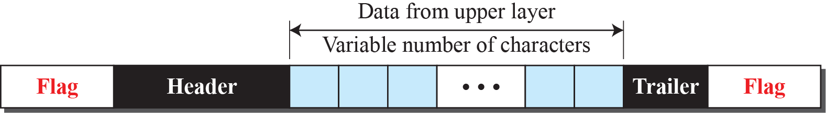
    11.1 DLC Services
    11.1 DLC Services
communication between two adjacent nodes.
framing, flow control, and error control.
    1.1.1 Framing
Frame Size
  Fixed-size and variable-size
  Character-Oriented Framing

Slide 5
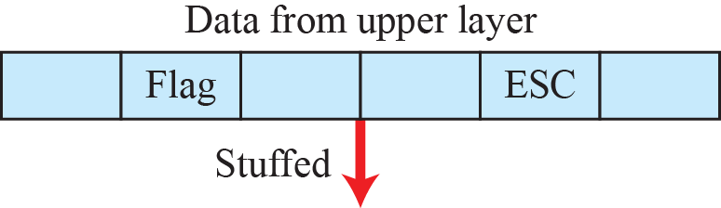
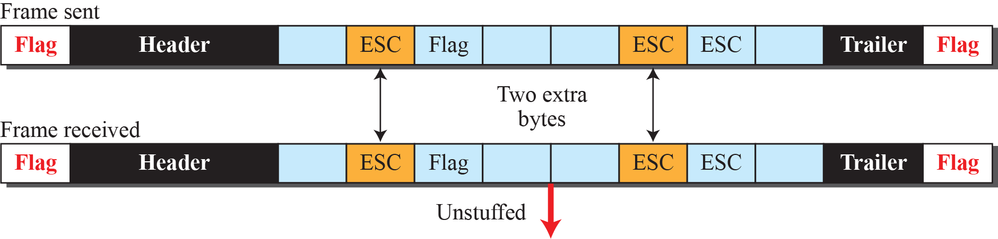

    11.1 DLC Services
  Transparent communication (byte stuffing)

Slide 6
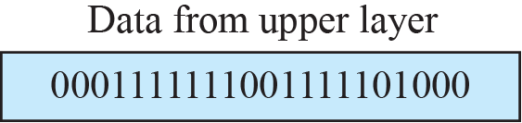
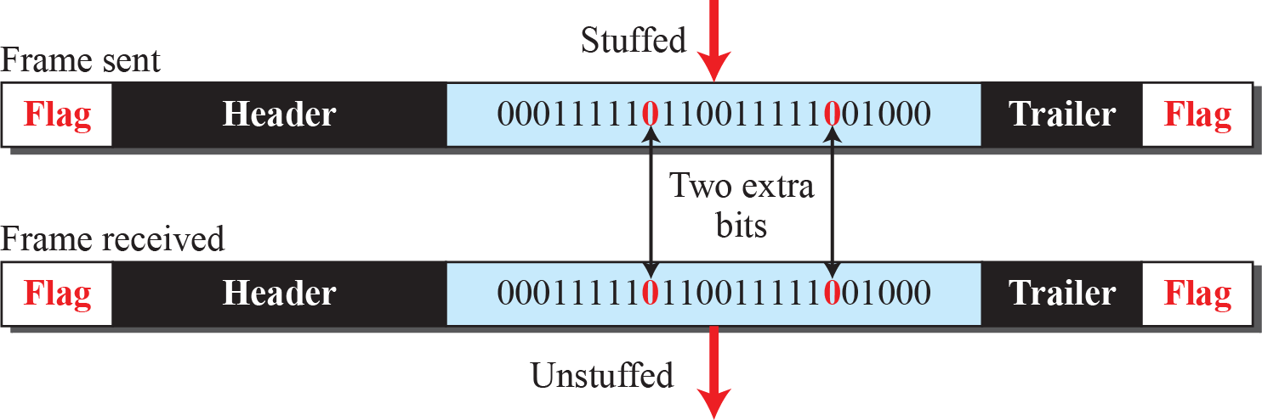
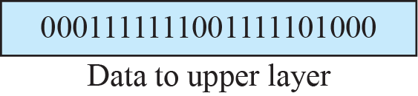
    11.1 DLC Services
  Bit-oriented protocol (bit stuffing)

Slide 7
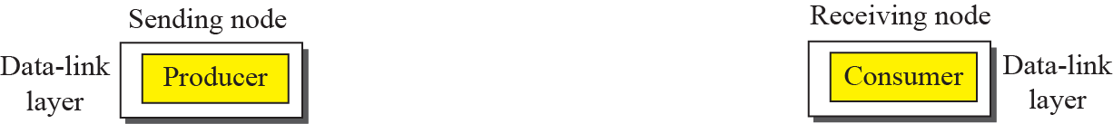


    11.1 DLC Services
    11.1.2 Flow and Error Control
Flow control
  Buffers
  Ex. 11.1
Error control
  very simple : CRC is used
  deliver data to network layer
  ACK
Combination of Flow and Error Control

Slide 8
    11.1 DLC Services
    11.3 Connectionless and Connection-Oriented
Connectionless Protocol
  no connections between frames
Connection-Oriented Protocol
  logical connection should first be established between the two nodes
  rare in wired network

Slide 9
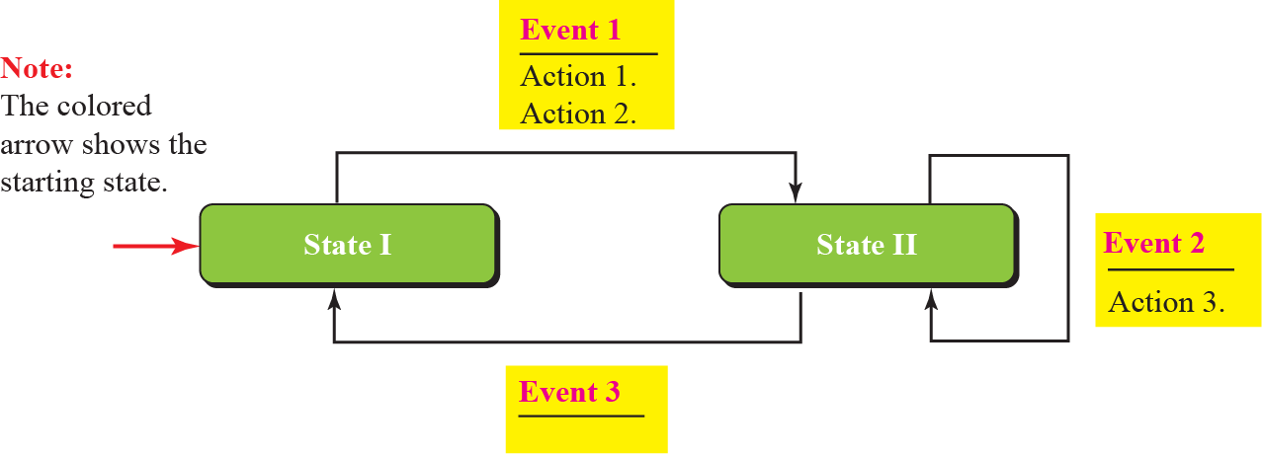
    11.2 DLC Protocol
    11.2 DLC Protocol
Simple,
Stop-and-Wait,
Go-Back-N, (disappeared)
and Selective-Repeat. (disappeared)
Fig. 11.6 FSMs

Slide 10
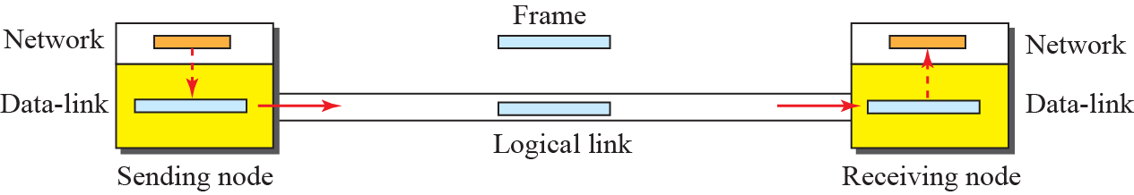
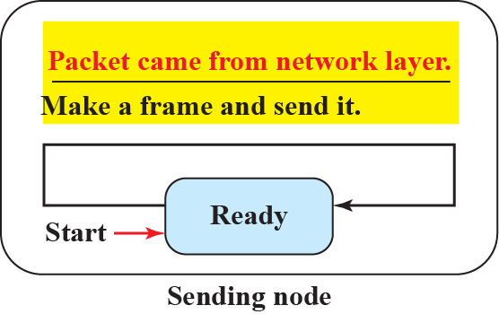
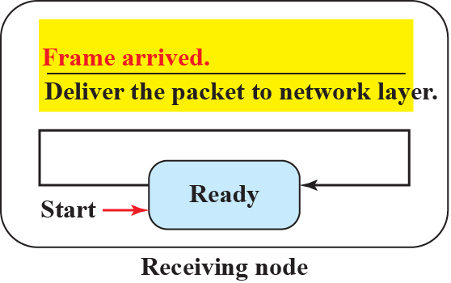
    11.2 DLC Protocol
    11.2.1 Simple Protocol
neither flow nor error control.
Fig. 11.7 Simple protocol
Fig. 11.8 FSMs Simple protocol

Slide 11
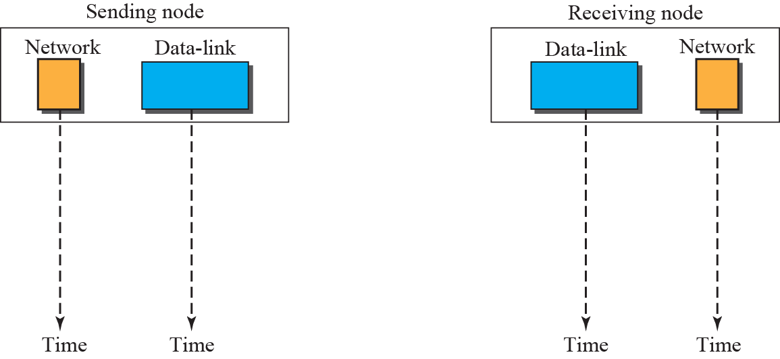


    11.2 DLC Protocol
Fig. 11.9 Flow diagram for Ex. 11.2

Slide 12
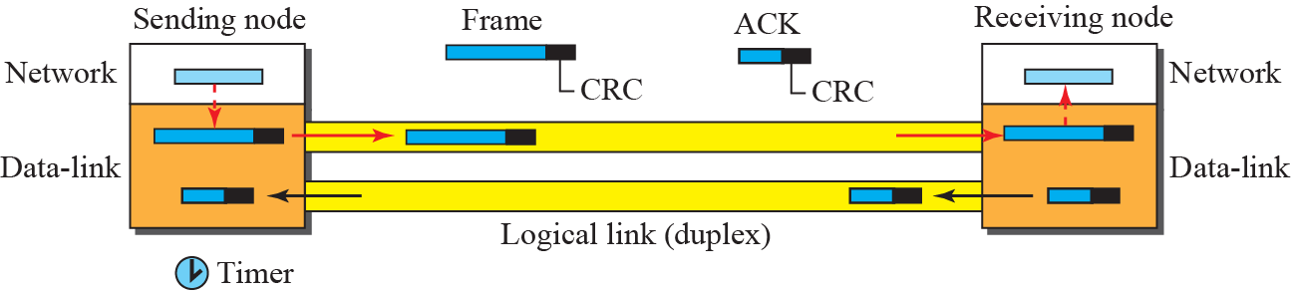
    11.2 DLC Protocol
    11.2.2 Stop-and-Wait Protocol
Fig. 11.10 Stop-and-Wait protocol

Slide 13
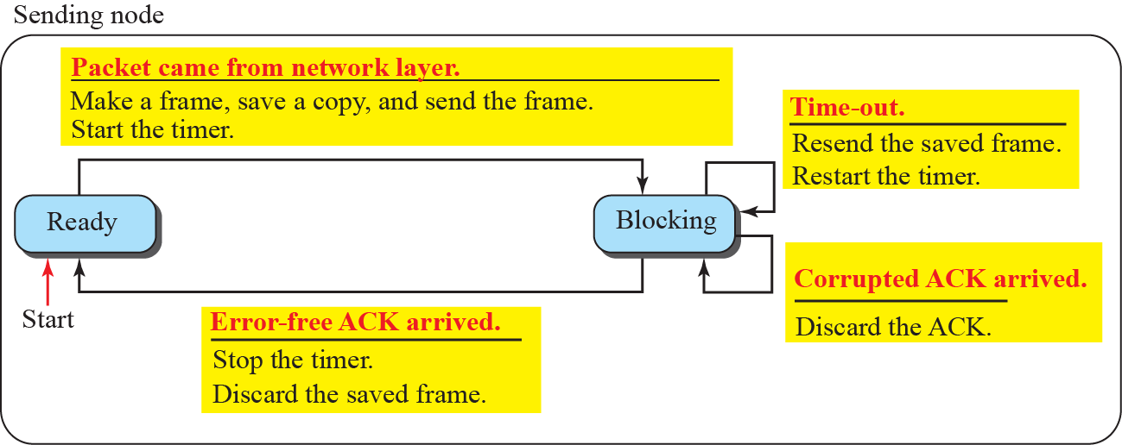
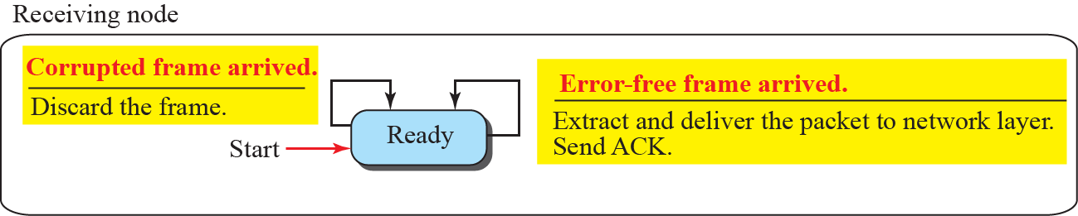
    11.2 DLC Protocol
Fig. 11.11 FSM for Stop-and-Wait protocol

Slide 14
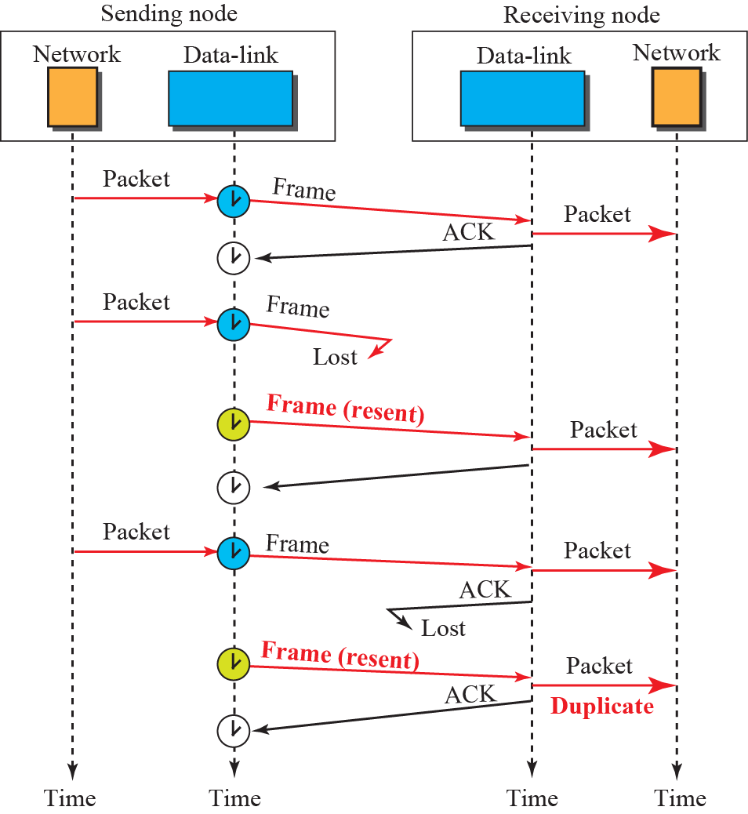
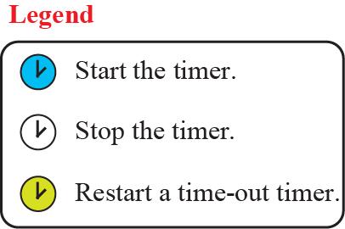
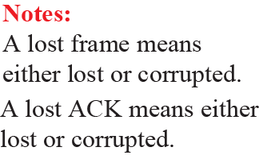
    11.2 DLC Protocol
Fig. 11.12 Flow diagram for Ex. 11.3

Slide 15
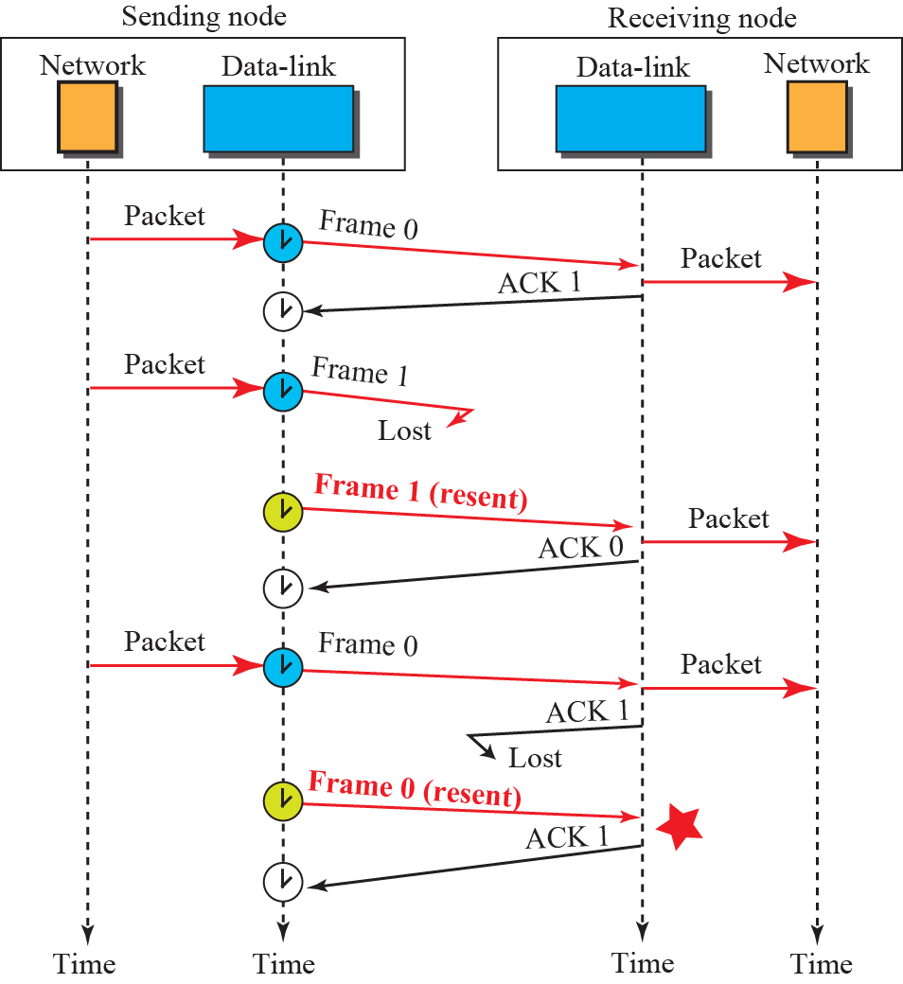

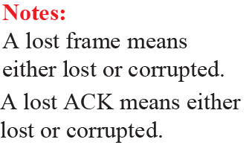
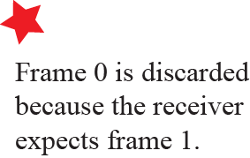
    11.2 DLC Protocol
Fig. 11.13 Flow diagram for Ex. 11.4

Slide 16
    11.3 HDLC
    11.2.3 Piggybacking
to make the communication more efficient, the data in one direction is piggybacked with the acknowledgment in the other direction.
    11.3 HDLC
is a bit-oriented protocol for communication over point-to-point and multipoint links
Stop-and-Wait
is the basis for other practical protocols such as PPP, Ethernet, or wireless LANs
    11.3.1 Transfer Mode
normal response mode (NRM)
asynchronous balanced mode (ABM).

Slide 17
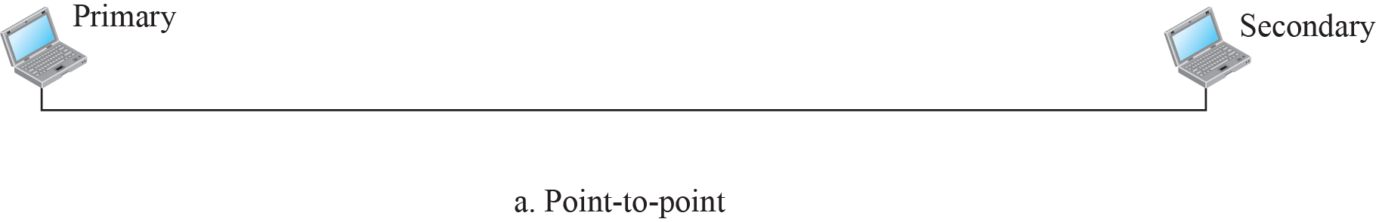


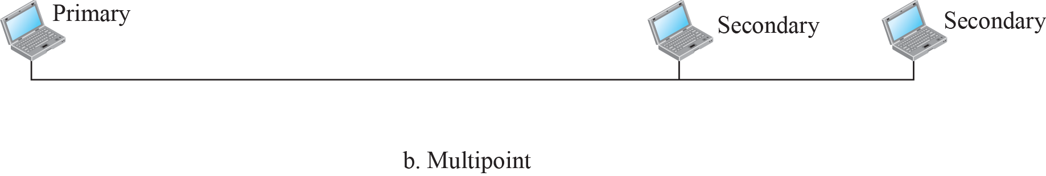
    11.3 HDLC
Fig. 11.14 Normal response mode

Slide 18
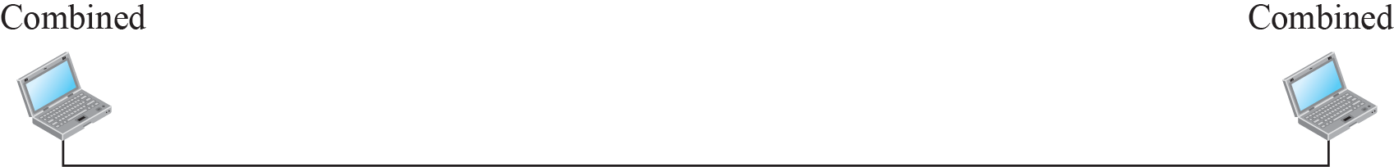



    11.3 HDLC
Fig. 11.15 Asynchronous balanced mode
    11.3.2 Framing
information frames (I-frames),
supervisory frames (S-frames),
and unnumbered frames (U-frames)

Slide 19
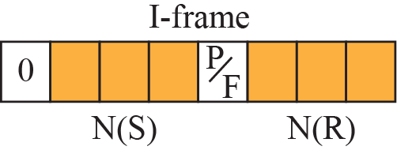
    11.3 HDLC
Flag field contains synchronizstion pattern 01111110
Address field contains the address of the secondary stationin
Control field is one or two bytes used for flow and error control
Information field contains the user’s data from the network layer or management information
FCS field is the HDLC error detection field. It contains 2- or 4- bytes CRC
Control Field for I-Frames
  First bit 0 means I-frame
  Next 3 bits, N(S), define the sequence number of the frame
  Next 1 bit, P/F (bit=1), means poll or final
  Next 3 bits, N(R), correspond to the acknowledgment number

Slide 20
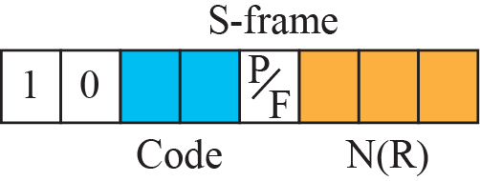
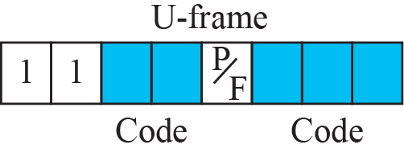
    11.3 HDLC
Control Field for S-Frames
  First 2 bits 10 mean S-frame
  Receive ready (RR): code 00
  Receive not ready (RNR): code 10
  Reject (REJ) : code 01
  Slective reject (SREJ): code 11
Control Field for U-Frames
  First 2 bits 11 mean U-frame
  used to create up to 32 different types of U-frames

Slide 21

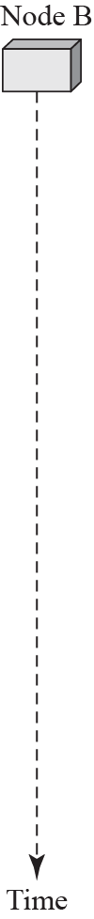
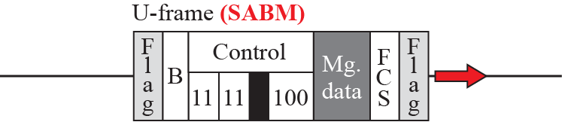
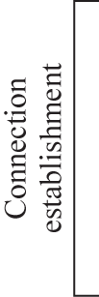
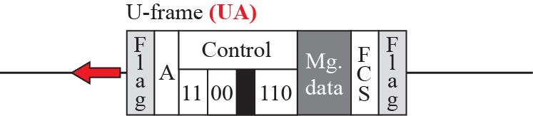

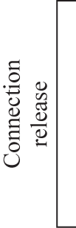
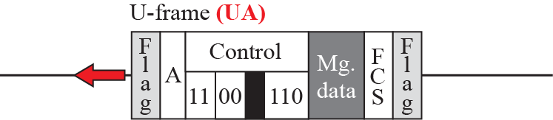
    11.3 HDLC
Fig. 11.18 Example of connection and disconnection

Slide 22
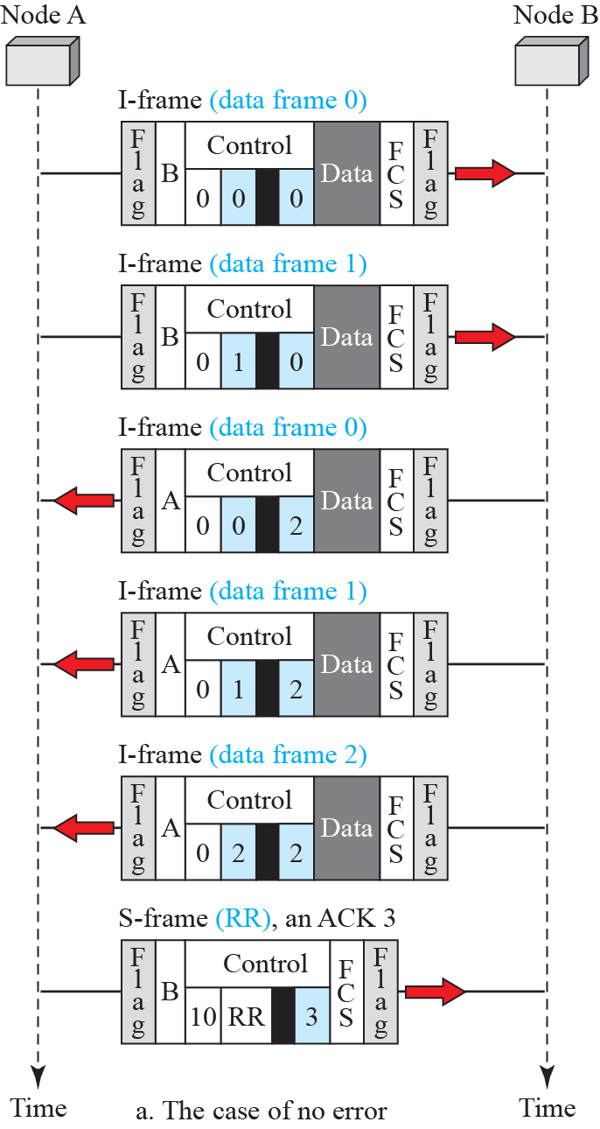
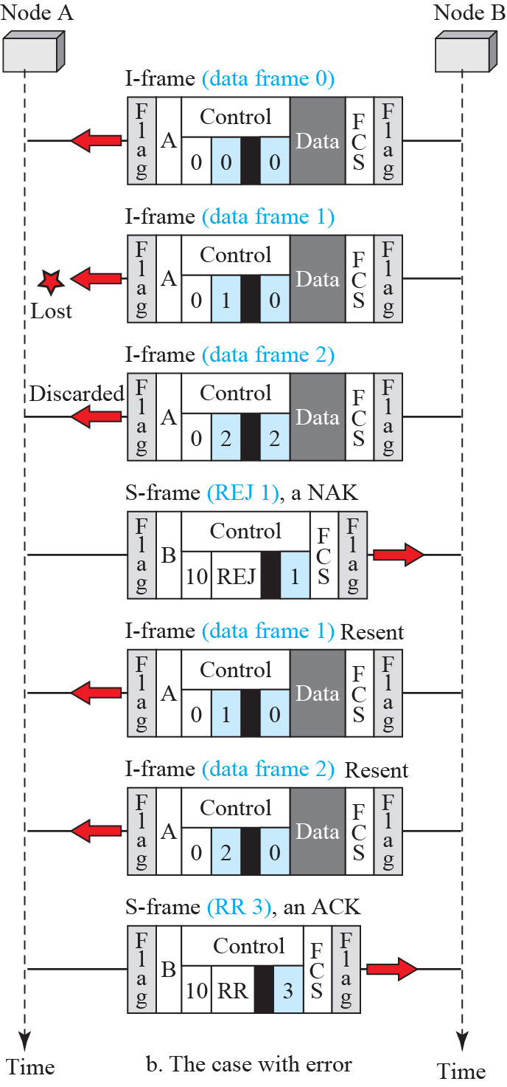
    11.3 HDLC
Fig. 11.19 Example of piggybacking with and without error

Slide 23
    11.4 PPP
    11.4 PPP
is one of the most common protocols for point-to-point access
is used to control and manage the transfer of data
11.4.1 Services
Services by PPP
  defines the format of the frame to be exchanged between devices
  defines how two devices can negotiate the establishment of the link and the exchange of data
  is designed to accept payloads from several network layers
  Multilink PPP provides connections over multiple links
  network address cinfiguration
Sevives not probides by PPP
  does not provide flow control
  has a very simple mechanism for error control
  does not provide a sophisticated addressing mechanism to handle frames in a multipoint configuration

Slide 24
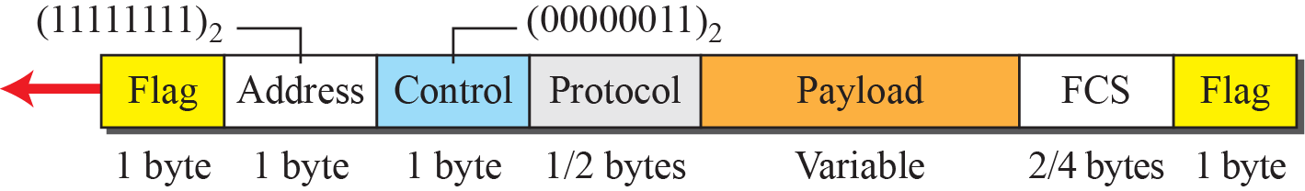
    11.4 PPP
11.4.2 Framing
Flag : 1-byte 01111110
Address: 1-byte constant value 11111111
Control: 1-byte constant value 0000 0011
Protocol: 1-2 bytes, defines either user data or other information
Payload: carrier either maximum 1500 bytes user data or other information
FCS: 2 or 4 bytes standard CRC
Byte Stuffing : 01111101

Slide 25
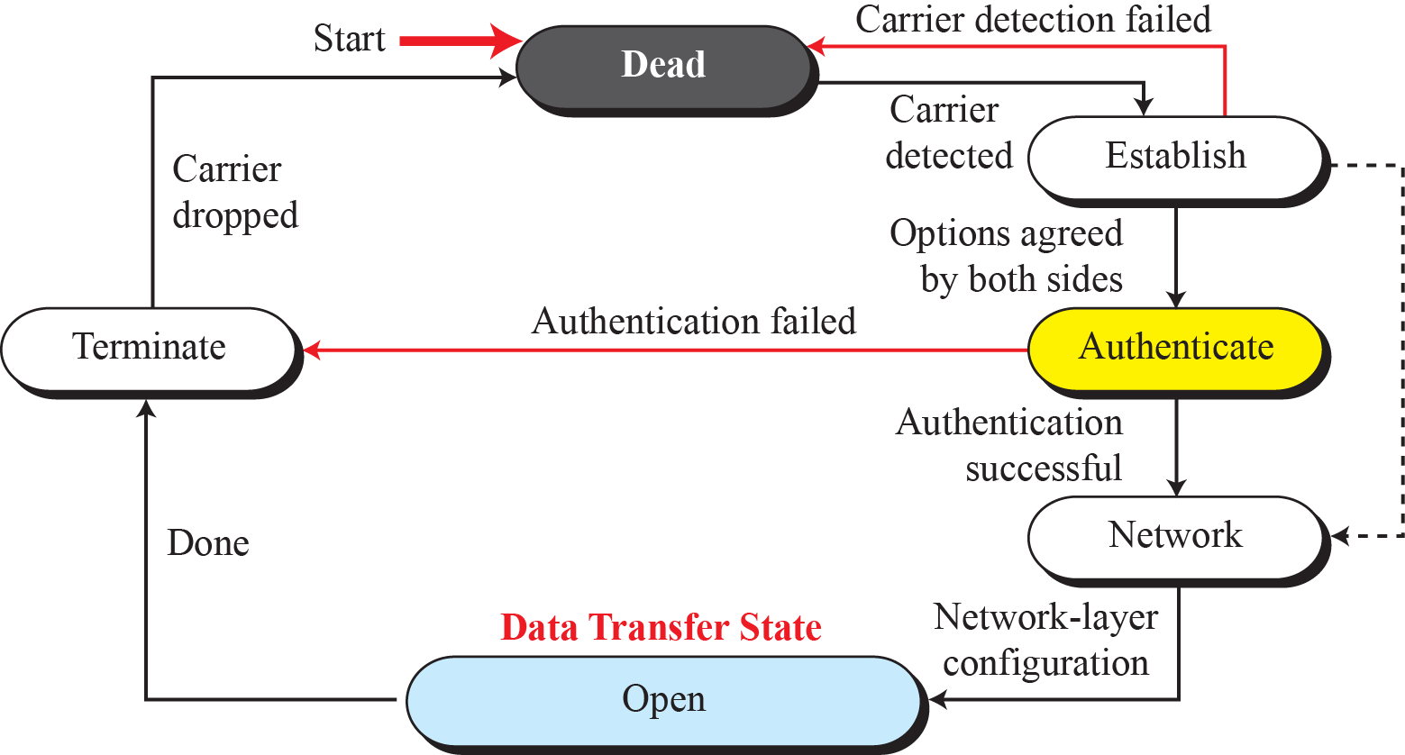
    11.4 PPP
11.4.3 Transition Phases
Fig. 11.21 Transition Phases

Slide 26
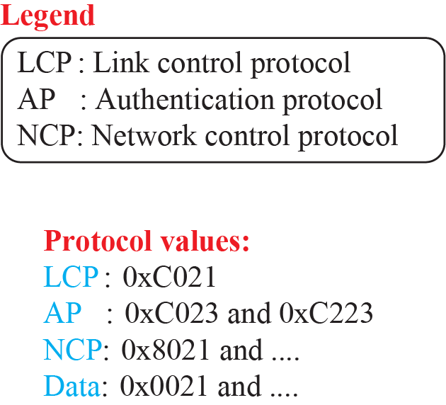
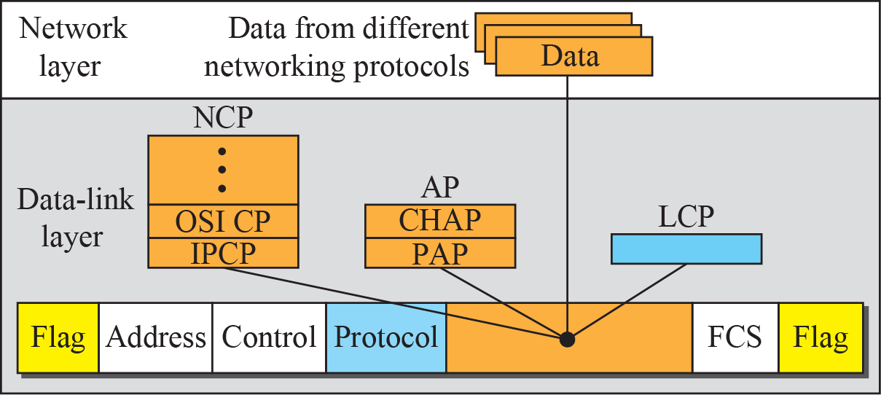
    11.4 PPP
11.4.4 Multiplexing
Fig. 11.22 : Multiplexing in PPP
LCP : 01111101
  is responsible for establishing, maintaining, configuring, and terminating links.
  provides negotiation mechanisms

Slide 27
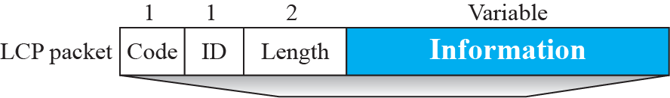

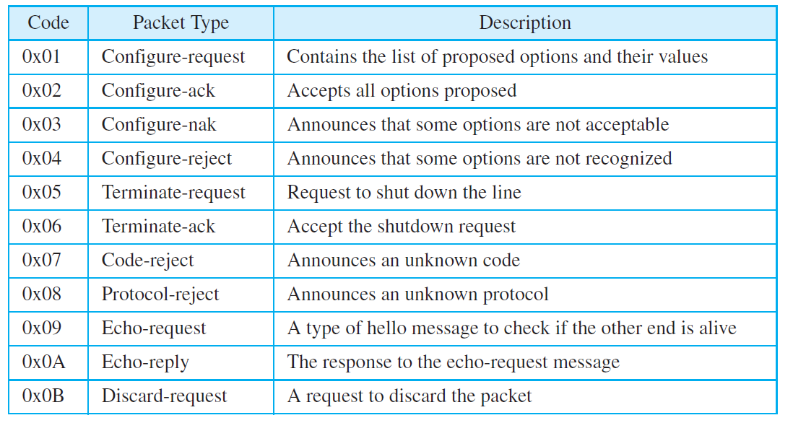
    11.4 PPP
Fig. 11.22 Multiplexing in PPP
Table 11.1 : LCP packets

Slide 28
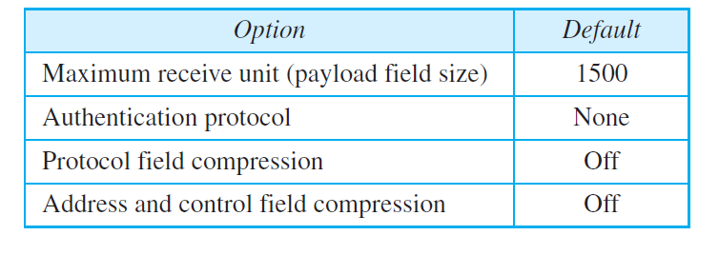
    11.4 PPP
Negotiation

Slide 29
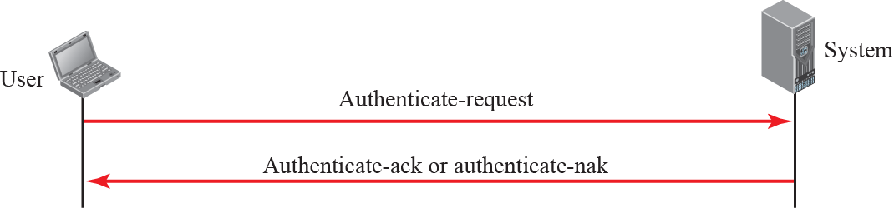
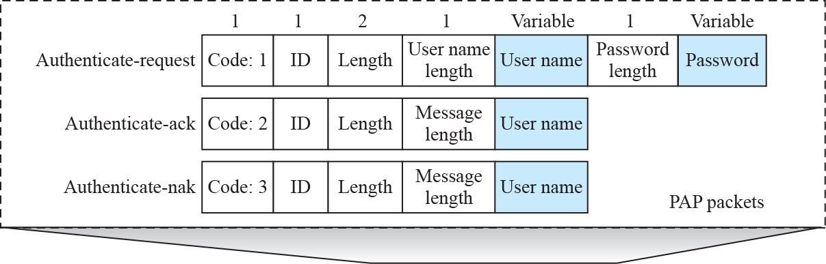
    11.4 PPP
AP
  PAP (password authentication protocol)
  CHAP (challenge Handshake authentication protocol)
Fig. 11.24 : PAP packets encapsulated in a PPP frame

Slide 30
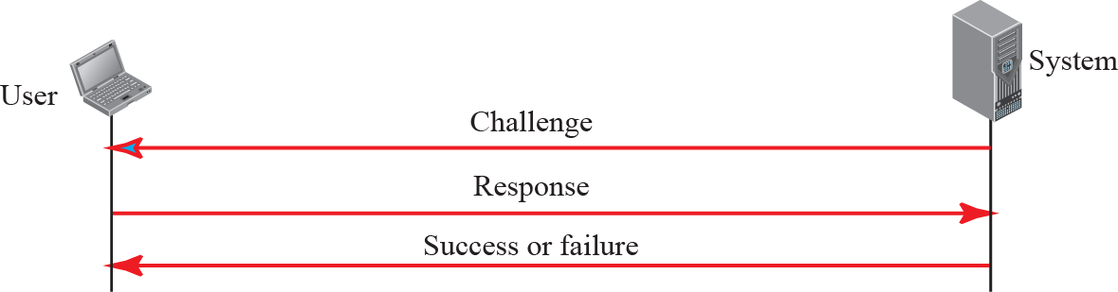
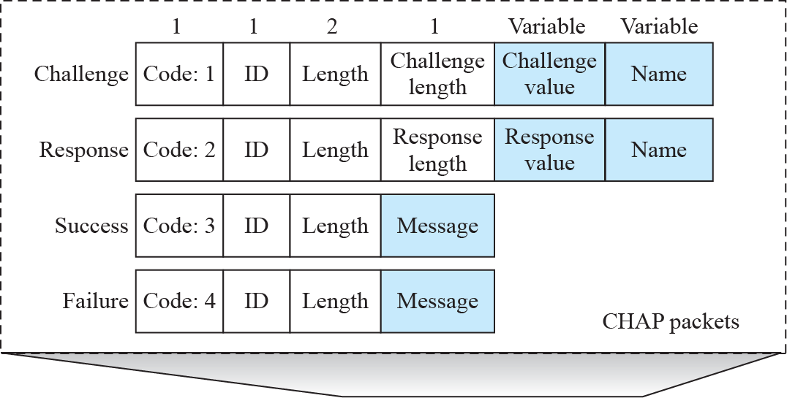
    11.4 PPP
Fig. 11.25 : CHAP packets encapsulated in a PPP frame

Slide 31
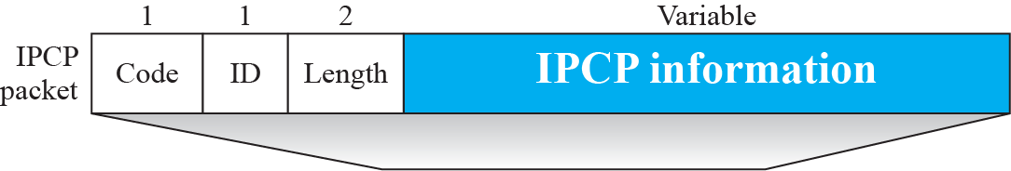
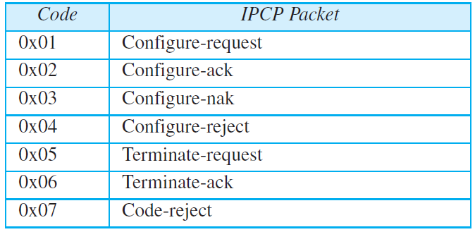
    11.4 PPP
NCP
  ICIP (internet protocol control protocol) : 0x 8021
  Other Protocol: OSI 0x8023, Xerox NS IDP 0x8025
Fig. 11.26 : ICIP packet encapsulated in a PPP frame
Table 11.3 Code value for ICIP packets

Slide 32
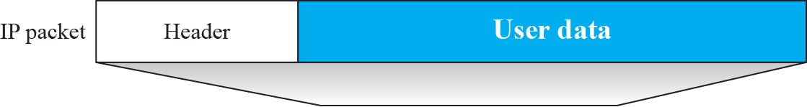
    11.4 PPP
Date from the Network Layer
  IP network layer data : 0x0021
  OSI network layer data : 0x0023
Fig. 11.27 : IP dapagram encapsulated in a PPP frame

Slide 33
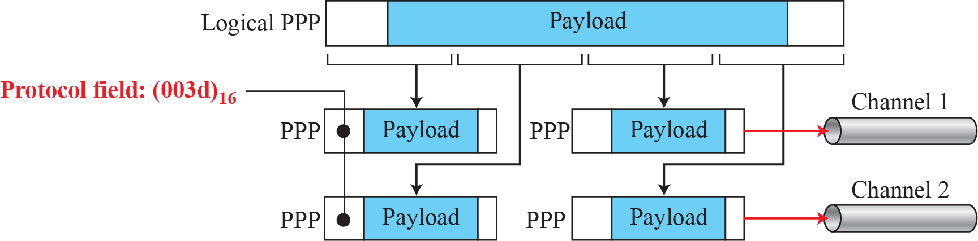
    11.4 PPP
Multipoint PPP
Fig. 11.28 : Multipoint PPP

Slide 34

    11.4 PPP
Ex. 11.7

Slide 35
    Homework
Homework
Solve Problems P11-1, P11-3, P11-9, P11-(11,14), P11-13
Read textbook pp. 325-354
Next Lecture
Chapter 12. Media Access Control (MAC)

